Slide 1
OMEGA PSI PHI FRATERNITY, INC.
CHI RHO CHAPTER
WEDNESDAY,
AUGUST 11, 1965

Slide 3
The History of Omega Psi Phi Fraternity, Inc.
- Omega Psi Phi Fraternity, Inc. was founded on Friday, November 17, 1911 at Howard University’s Thirkield Hall in the office of associate professor Dr. Ernest Everett Just.
- 4 Founders: Dr. Ernest Everett Just, Bishop Edgar Amos Love, Dr. Oscar James Cooper and Professor Frank Charles Coleman.
Motto: Friendship is Essential to the Soul
4 Cardinal Principles: Manhood, Scholarship, Perseverance and Uplift
Colors: Royal Purple and Old Gold

Slide 4
OUR FOUNDERS

Slide 5
Dr. Ernest Everett Just (1883-1941)
Dr. Ernest E. Just was born in Charleston, South Carolina.
Graduated from the Industrial School of the State College,
Orangeburg, South Carolina.
Attended the Kimball Union Academy in Meriden, New Hampshire
Received Bachelor of Arts Degree from Dartmouth College
(Phi Beta Kappa)
Received Doctor of Philosophy Degree, University of Chicago
Awarded the Spingarn Medal by the NAACP in 1915
Placed on the Black Heritage Series Stamp by the United States Postal Service

Slide 6
Bishop Edgar Amos Love (1891-1974)
Bishop Edgar A. Love was born in Virginia
Graduated from the Academy of Morgan College
Received Bachelor of Arts Degree from Howard University, 1913
Received Bachelor of Sacred Theology Degree from Howard University,
1916
Received Bachelor of Divinity Degree from Boston University, 1918
Received Doctor of Divinity Degree (Honorary) from Morgan College, 1935
U.S. Army Chaplain, World War II
Bishop, Methodist Church

Slide 7
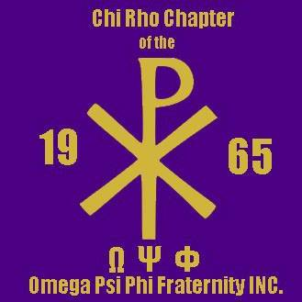

Slide 8
Dr. Oscar James Cooper (1888-1972)
Dr. Oscar J. Cooper was born in Washington, D.C.
Graduated from the M Street High School, Washington, D.C.
Received Bachelor of Science Degree from Howard University, 1913
Received Doctor of Medicine Degree from Howard University, 1917
Practiced medicine in Philadelphia, PA for 50 years

Slide 9
Professor Frank Charles Coleman (1890-1967)
Professor Frank Coleman was born in Washington, D.C.
Graduated from the M Street High School in Washington, D.C.
Received Bachelor of Science Degree from Howard University, 1913
Received Master of Science Degree from University of Chicago
Advanced Training, University of Pennsylvania
Professor and head of the Physics Department at Howard
University
U.S. Army Officer, World War I

Slide 11
History of Chi Rho Chapter
Chi Rho Chapter of the Omega Psi Phi Fraternity Inc. was charted to afford an opportunity for all unaffiliated Omega men of Long Island to meet. On August 11, 1965, the Chapter Charter for Chi Rho Chapter was signed by the Supreme Council of Omega Psi Phi Fraternity, Inc. Chi Rho is the first chapter chartered and founded on Long Island and is known as the Pearl of Long Island. Chi Rho oversees all of Suffolk County, NY. The ten charter members of Chi Rho Chapter and first officers were:
Frank Nichols*- Basileus
Harrison Smith*- Vice Basileus
Daniel Henderson*- Keeper of Records and Seals
James Lewis*- Keeper of Finance
Charles Belfield*- Keeper of Peace
Clarence Johnson*- Chaplain
Ercelle Williams*- Editor to the Oracle
Walter Bailey*- Dean of Pledges
Aubrey Greene*
John Van Buren*
The officers of Chi Rho Chapter were officially installed on October 29, 1965 at the home of Brother Harrison Smith at 58 Wright Street, North Babylon, New York. The National and District Officers that officiated the installment were:
George Meares*- Grand Basileus
James Avery*- 2nd District Representative
James Murray*- District Keeper of Records and Seals
Rudy Powell*- Past First Vice District Representative
Nathaniel Burrell*- Past District Keeper of Records and Seals

Slide 12
History of Chi Rho Chapter (cont.)
The Chapter Motto is:
Challenge Rededication
Hope Happiness
Initiative Optimism
Since its inception, Chi Rho chapter has been involved in community activities which embody the Fraternity’s cardinal principles of Manhood, Scholarship, Perseverance, and Uplift. The chapter’s signature programs are:
Purple and Gold Dance Masquerade, Men Who Cook (started in 1990), XP Fish Fry, Thanksgiving Basket donations, Christmas Basket donations, XP Blood Drive, Fatherhood Initiative Month consisting of the Father Son Outing, Father Daughter Dance and the Pride for Fatherhood Breakfast and the Domestic Violence walk. Many of our programs are designed to provide funding for mentoring and scholarships to college bound minority youth. XP also participates and upholds our Fraternity’s mandated programs yearly. Through the years, the chapter has provided over 50 scholarships and has awarded many young people on their talents through the Talent Hunt Program. Chi Rho has also supported the United Negro College Fund (UNCF) and many other charitable means.
Chi Rho has also sponsored other social action endeavors through support of the NAACP, voter campaign support, and recognition of other community achievers.
In 2010, Chi Rho chapter held its first Domestic Violence walk in conjunction with the Suffolk County Alumnae Chapter of Delta Sigma Theta Sorority, Inc. and donated approximately $3000 to the Suffolk County Coalition against Domestic Violence.
In 2010 Chi Rho held its first Pride for Fatherhood Breakfast. The platform for this was in recognition of our very own chapter brother Lee Isabelle Sr. In June of 2011, Chi Rho Chapter received a signed recognition citation from President Barack Obama for our commitment to Fatherhood, through our Pride for Fatherhood Breakfast, highlighting our support of hard working fathers in the community raising their families and being positive role models in their lives.
In 2017, XPotential, a not for profit 501©3 organization, was incorporated to further help the Suffolk County Long Island Community.
In 2018, Chi Rho’s final charter member Brother Ercelle Williams entered Omega Chapter.
In 2019, Chi Rho created a challenge coin.

Slide 13
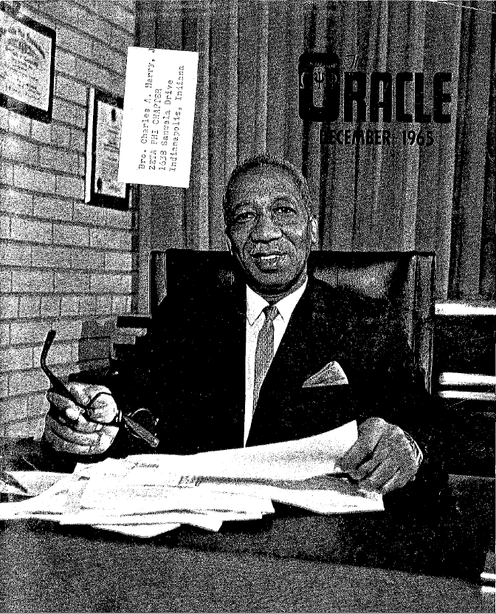

Slide 14
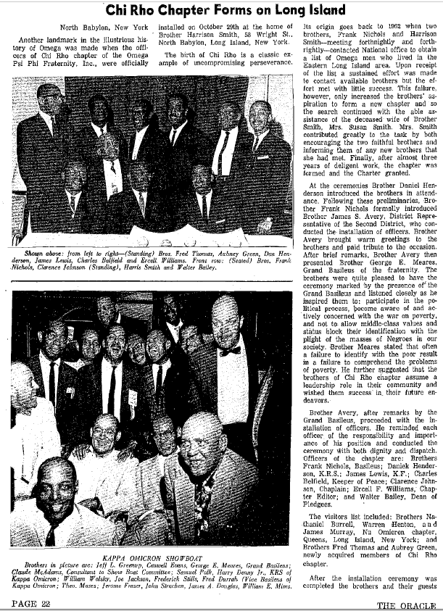

Slide 15
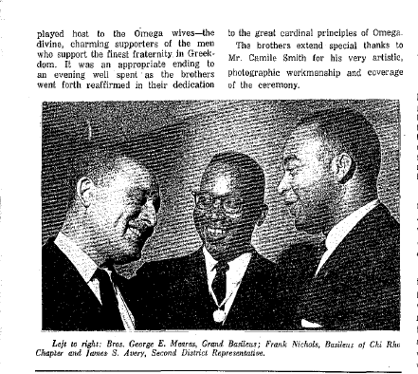

Slide 16
CHI RHO CHAPTER COIN
FRONT
BACK

Slide 17
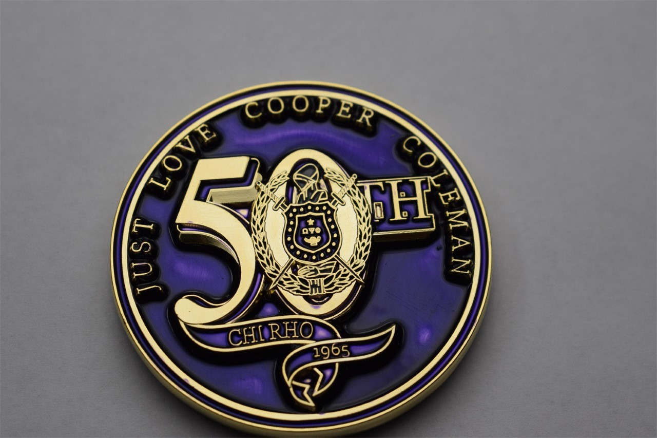
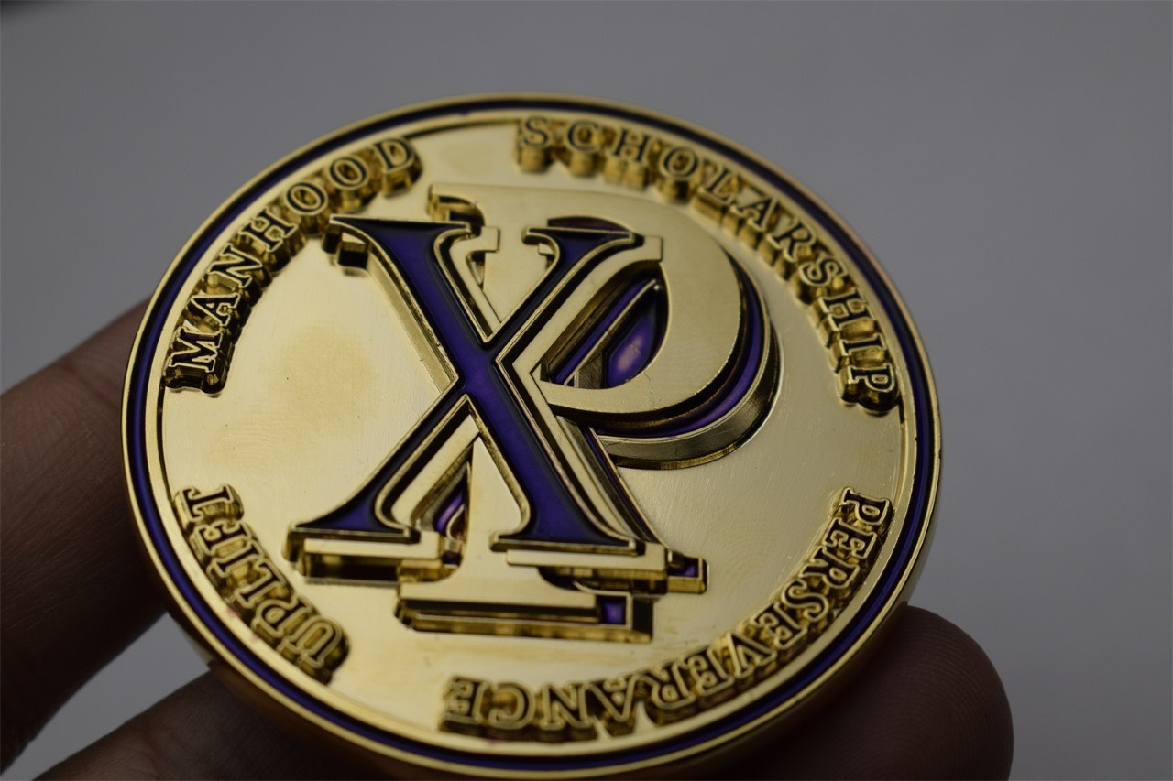
CHI RHO CHAPTER 50TH ANNIVERSARY COIN
FRONT
BACK

Slide 18
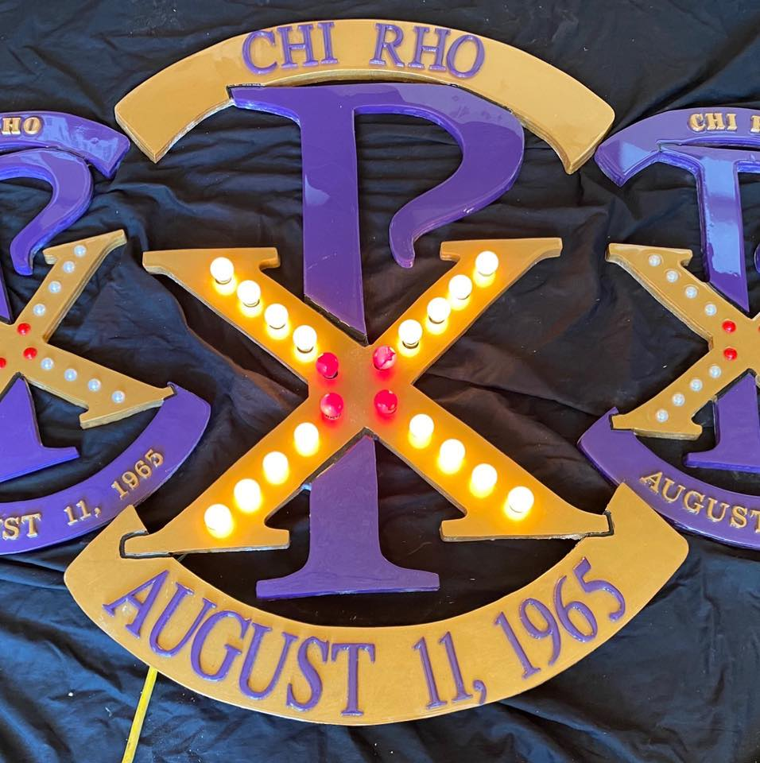

Slide 19
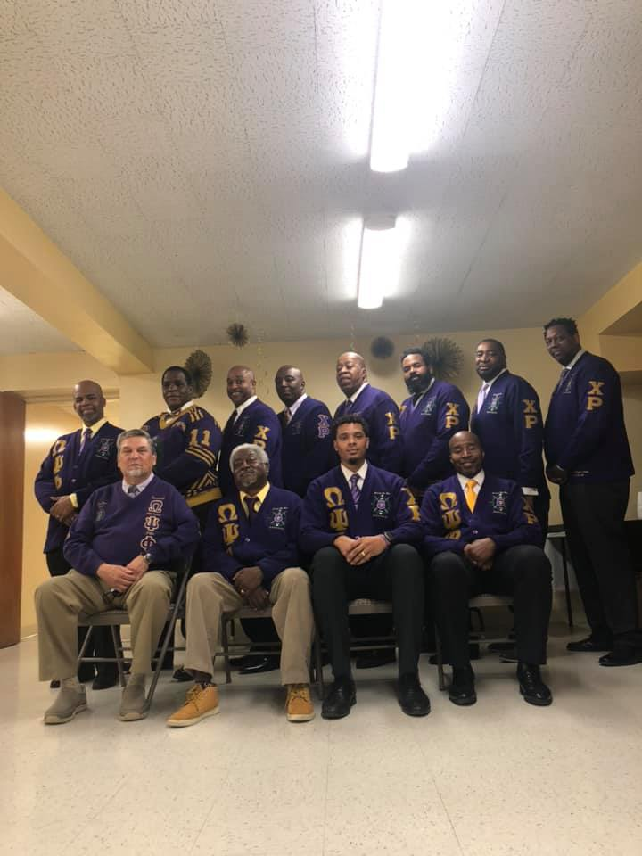

Slide 20
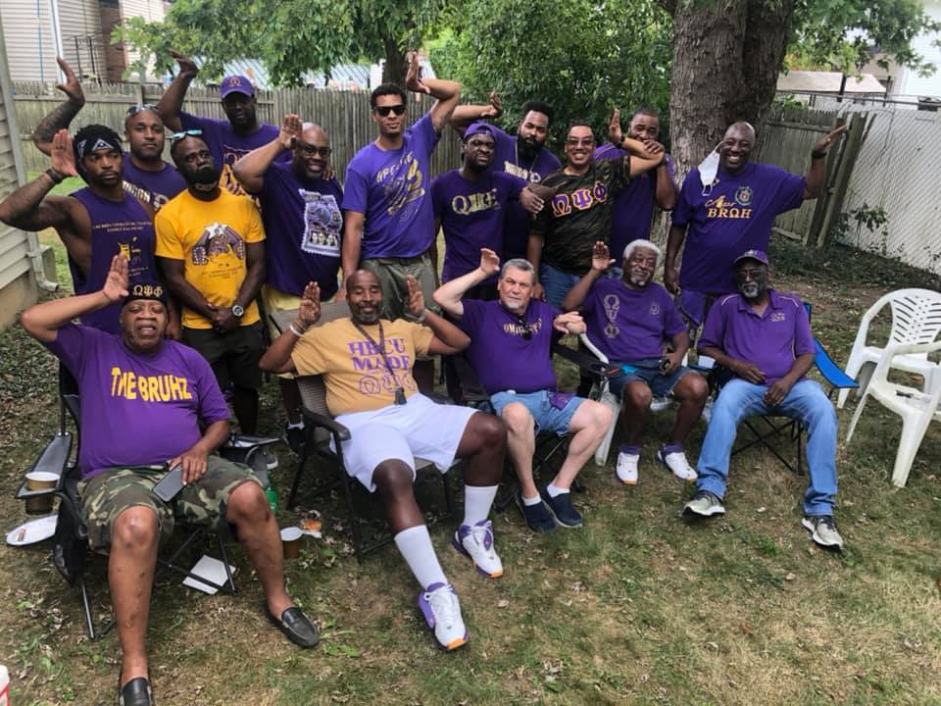

Slide 21
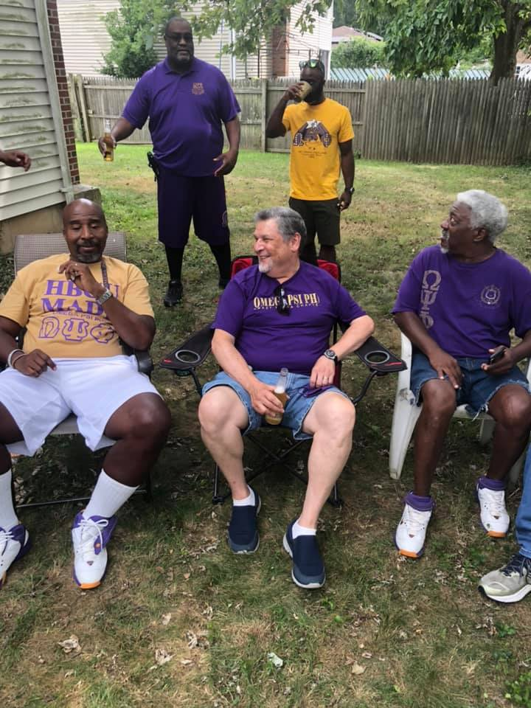

Slide 22
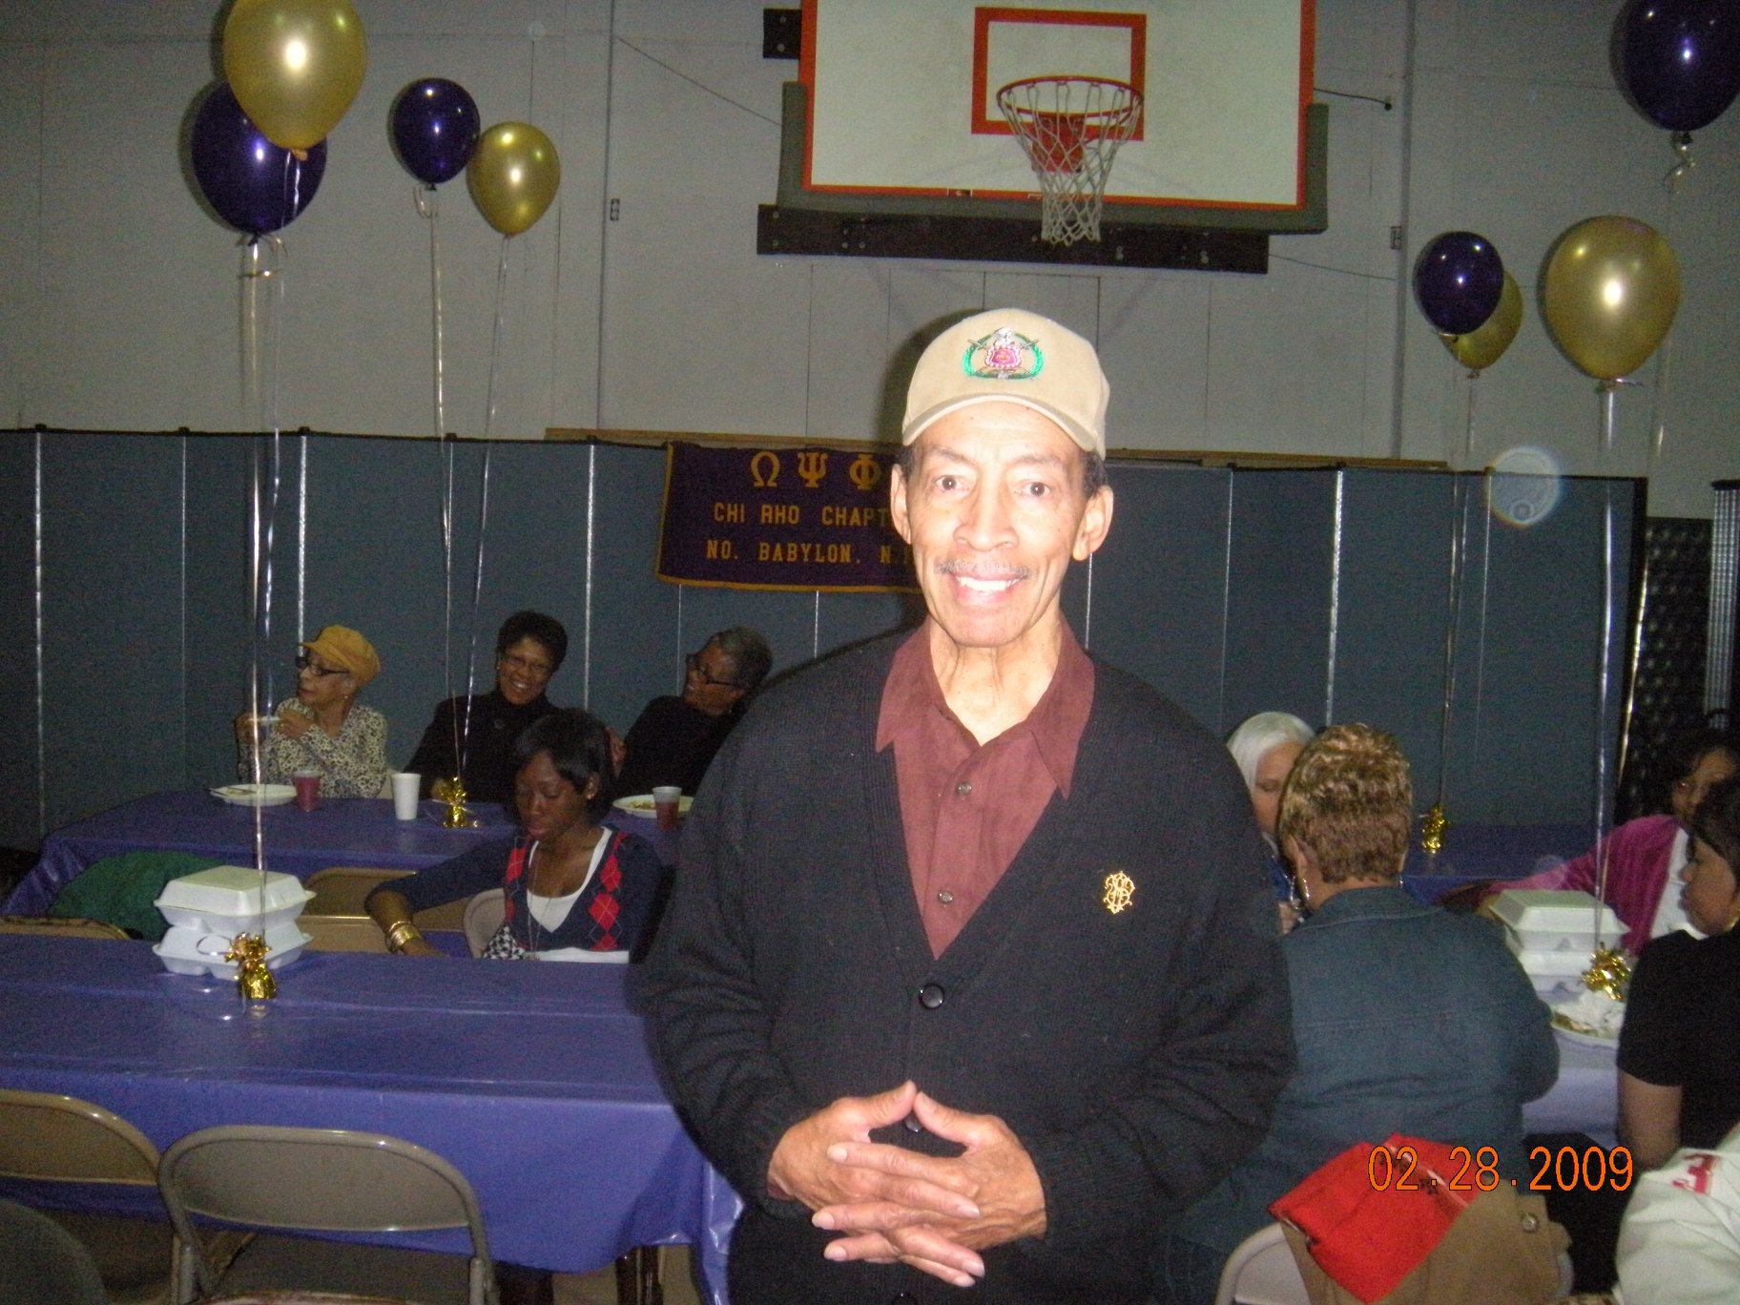

Slide 23
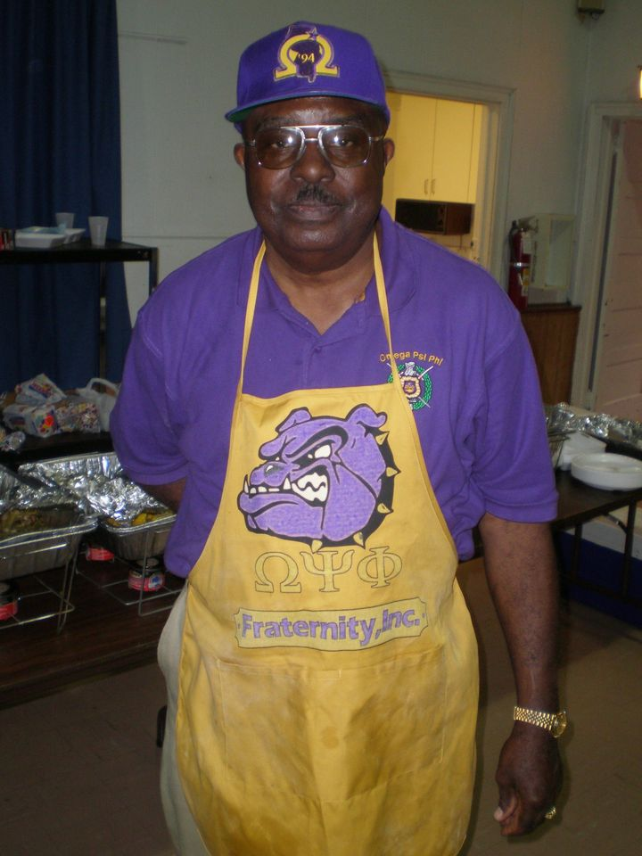

Slide 24
CONTACT US
Website: www.chirhochapter.org
Email: chirhochapter1965@gmail.com
Facebook Page: https://www.facebook.com/chirho.chapter
Phone and email:
Chris Carter (Basileus)- chriscarter@yahoo.com
Donnie Daal (Vice Basileus)
Leonard Edwards (Keeper of Finance)
Charles Green (Keeper of Records and Seal)

